Slide 1
Predicting the BEST NFL Defensive Team
STAT 823 Project
Denise Bradford
12/16/2019

Slide 2
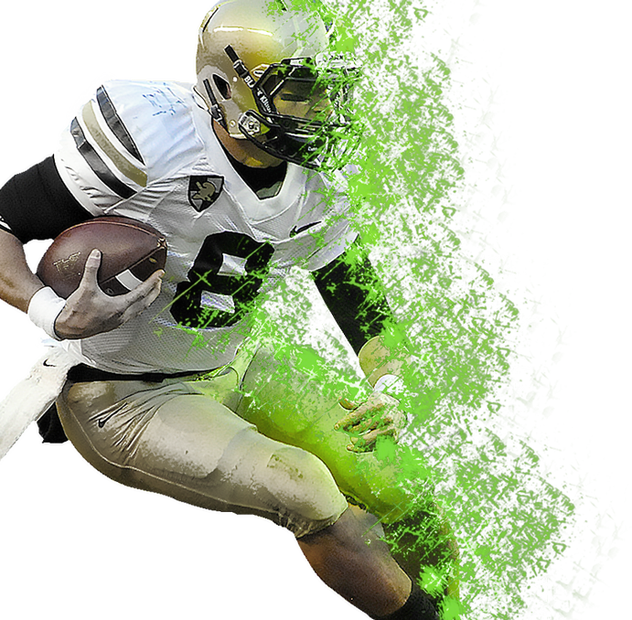
Outline
01
Defense Formations
02
Data Management
03
Statistical Analysis
04
Conclusions

Slide 3
Defense Formations
Commonly used Formations

Slide 4
Defensive Player Positions
Safety (S)
Defensive End (DE)
Linebacker (LB)
This position has designated the players at each end of the defensive line.
plays behind the defensive line
Covers the back field
Free Safety/ Strong Safety (FS/ SS)
Defensive Tackle (DT)
Middle Linebacker (MLB)
The defensive tackle typically lines up opposite one of the offensive guards
often known as the "quarterback of the defense"
Covers the run/ the last defense on the field
Nose Tackle (NT)
Outside Linebacker (OLB)
Corner Back (CB)
Covers the receivers on the line of scrimmage
The most interior defensive tackle who sometimes lines up directly across from the ball
as known as the ”strongside” or “weakside” linebacker

Slide 5
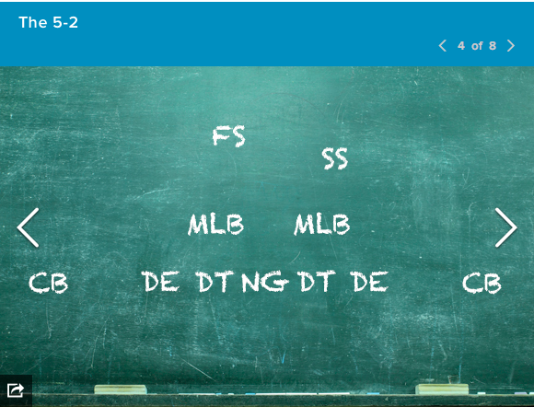
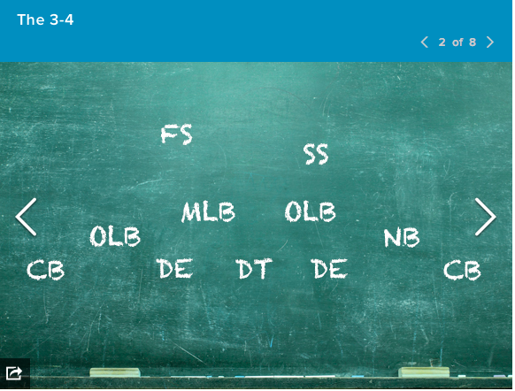
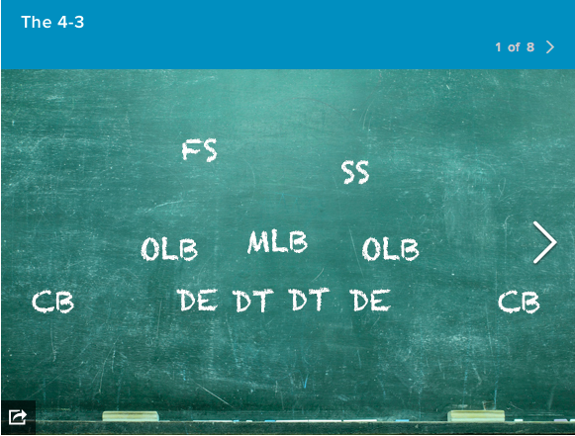
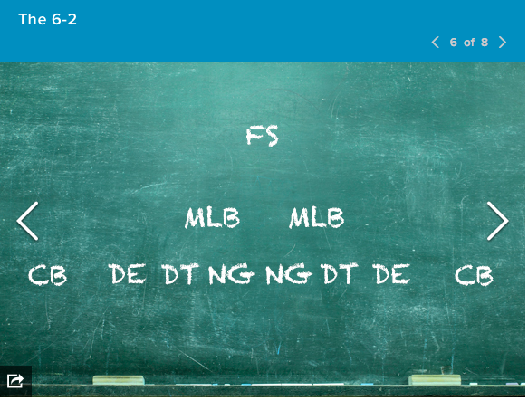
Defense Formations

Slide 6
Data Management
Collecting and Combing Datasets

Slide 7
NFL Play-by-Play Data 2009-2018
~ 1GB
NFL Play Statistics (2004 - Present) Database
~ 1.2 GB
NFL Combine Data 2005 -2018
~ 1 MB

Slide 8
Dataset For Analysis
15%
25%
I used the NFL Play Statistics Database to get the Players’ Full Name and position in the NFL.∔
I used NFL Combine Data to potentially predict the next best player in the current season.*
60%
I used the NFL play-by- play dataset to get the information for the Fantasy Points ∔
∔ www.kaggle.com/Datasets
* https://www.pro-football-reference.com/play-index/nfl-combine-results

Slide 9
Assumptions
Season Fantasy Football Points*
1 point per solo tackle
1 point per pass defended
3 points per fumble forced
½ point per assist tackle
2 points per sack
Opponent’s Offensive Possession Time
The time on average the Opponent's Offensive Team had the ball on the field.
Why? Because it will tell more about the strength of the defense.
“Best Player” in the three groups
Best Player based the average fantasy points and the lowest possession time from the previous three seasons (2015, 2016 & 2017)
Defensive Backs (includes Safety, Free Safety, Cornerbacks)
Defensive Ends (includes Defensive Tackles, Nose Tackles)
Linebackers (includes Middle Linebacker, Outside Linebacker)
* https://fantasydata.com/api/fantasy-scoring-system/nfl

Slide 10
Defensive Player Positions
Safety (S)
Defensive End (DE)
Linebacker (LB)
This position has designated the players at each end of the defensive line.
plays behind the defensive line
Covers the back field
Free Safety/ Strong Safety (FS/ SS)
Defensive Tackle (DT)
Middle Linebacker (MLB)
The defensive tackle typically lines up opposite one of the offensive guards
often known as the "quarterback of the defense"
Covers the run/ the last defense on the field
Nose Tackle (NT)
Outside Linebacker (OLB)
Corner Back (CB)
Covers the receivers on the line of scrimmage
The most interior defensive tackle who sometimes lines up directly across from the ball
as known as the ”strongside” or “weakside” linebacker

Slide 11
Statistical Analysis
Random Forest and Neural Network

Slide 12
Neural Network / Failure
In general, a complete neural network is straightforward: one enter variables as inputs and after some calculations, an output is returned.
For example one inputs variables such as an image of a dog and an output is returned as “dog” ***
The network started to memorize predictions in the data as I learned more and more about fitting the network.***
Predictions started in the mid 60% and increased to 95%, which I understand could be a downfall in overusing the data.
***For more in detail explanations, please see James or Kevin’s presentation

Slide 13
Random Forest
Random forest runtimes are quite fast, and they can deal with unbalanced and missing data.
Random Forest weaknesses are that when used for regression they cannot predict beyond the range in the training data, and that they may over-fit data sets that are particularly noisy.
In terms of my data, many players do not have combine data or players do not have stats in each measured variable.

Slide 14
Conclusion
Further Work and Questions

Slide 15
Conclusion
 | Defensive Backs | Defensive Ends | Linebackers
Best Team | ATL, BAL, CIN, NYJ | DET, NO, GB | BUF, NE
Possession Time | 30.53 | 30.97 | 30.29
Fantasy Points | 7.20 | 6.73 | 8.08
40 yard dash | 4.37 | 4.61 | 4.58
3 cone | 2.63 | 3.11 | 2.44
Bench Reps | 15.25 | 24.00 | 17.00
Vertical Jumps | 35.50 | 31.00 | 26.50
Broad Jumps | 52.48 | 50.75 | 64.80

Slide 16
Conclusion
Random Forest Statistical model using a binary response for best
Defensive Backs about 67% of the time using their combine data
Defensive ends about 62% of the time using their combine data
Linebackers about 71% of the time using their combine data

Slide 17
Discussion
Predicting a Defensive Team takes a lot of work to get the right measures! Especially values “off the ball”.
Use a different type of classification method to determine the best players in each group
Making sure that the data are complete (include yards after the interceptions, touchdown after interceptions, include the yards lost after a sack, yards after a forced fumble)
Possibly work College statistics into the data for rookies.

Slide 18
Future Work
Develop a team based on the ”Best” Defensive Team including the rookies for 2019 season using Combine Data
Use an Adversarial Neural Network that will allow the “best teams” to battle each other.
Create a variable that will have a differences in passes defended for the best CB, FS and SS (season to season level or a game to game level)
Weight the possession time and fantasy points when looking at the best players in each of the three categories.

Slide 19
Thank you
Reka Howard, PhD
Walt Stroup, PhD
Dean Dustin
Nate Skrdla

